Slide 1
Automatic Attendance System Group – Iconic(Priyanka Singh - *824 & Devy Ratnasari - *309)

Slide 2
Project Life Cycle
PROJECT PLANNING &
ANALYSIS
USE CASE
Automatic Attendance System
SCOPE
DESIGN
TECHNOLOGY USED
FEATURE & FUNCTION

Slide 3
Project Planning & Analysis
PROJECT KICK-OFF
MVP
MMP
FINAL PRODUCT
Preliminary scope of project
Technology to be used
Use case analysis
Features & functions
Functional prototype
20% approved features running
Complete functioning product
Fully functional final product
Full project details

Slide 4
Preliminary Scope
PROBLEM
SOLUTION
Manual attendance is tedious and time-consuming
Additional administrative tasks for teachers
Vulnerable to proxies and manual errors
AI powered face recognition solution
Uses computer vision and machine learning algorithms to mark the attendance
Will work on face recognition where each student’s picture is saved on the server
System will recognize the faces and verify the presence or absence of each student
Can be implemented at any learning institute
Can be expanded to other facilities like offices or organizations

Slide 5





Technology Used
Google Cloud
Price and Flexibility
OpenCV
Facial Recognition
Tensorflow
Python
Github
Web Development
HTML

Slide 6
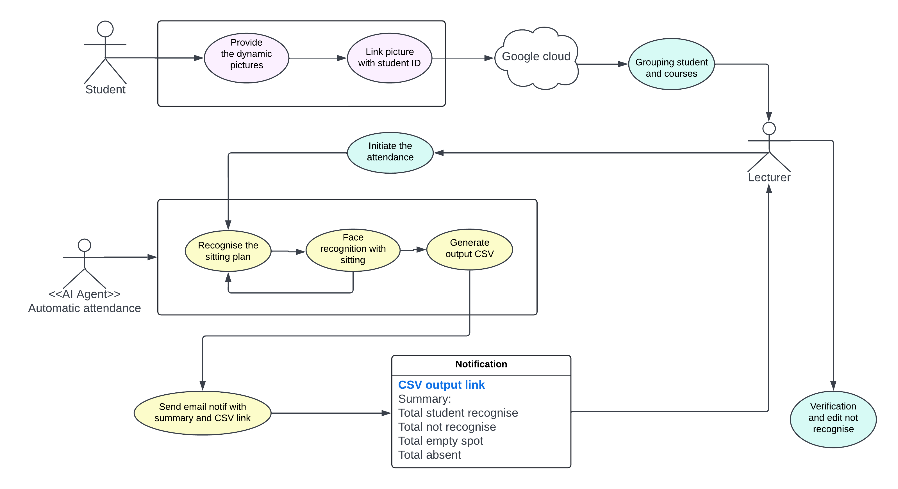
Use Case

Slide 7
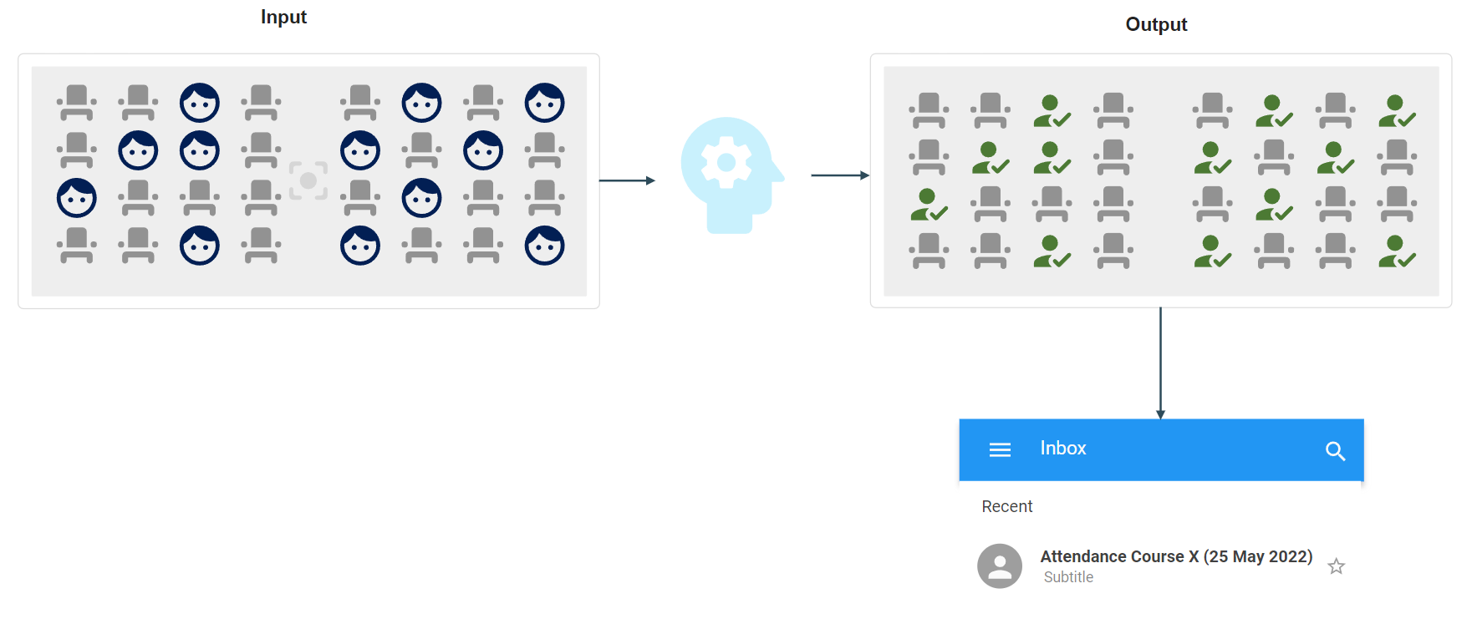
Design

Slide 8

Features & Functions
TACKLE PROXY ATTENDANCE
TECHNOLOGY POWERED
ELIMINATE HUMAN ERROR
INCREASES PRODUCTIVITY
SCALABLE
Students can’t mark proxy attendance
AI Based
Cloud Based
Built on face detection & recognition algorithms eliminating the chance of human error
Ease of attendance
Saves time
Reduces efforts
Can be scaled to include additional features & other use cases

Slide 9
Thank You

